Slide 1
Predicting Childhood Obesity – A Local Analysis of the NCMP in Hertfordshire
Victor Yu
Public Health Evidence and Intelligence, Hertfordshire County Council
NHS-R Conference 2022 | 2022-11 | PH.Intelligence@hertfordshire.gov.uk

Slide 2
Background
The National Childhood Measurement Programme (NCMP) measures the height and weight of children in Reception (aged 4-5) and Year 6 (aged 10-11) in all schools within England as part of government strategy to assess child obesity, along with:
inform local planning and delivery of services for children
gather population-level data to allow analysis of trends in growth patterns and obesity
increase public and professional understanding of weight issues in children and
be a vehicle for engaging with children and families about healthy lifestyles and weight issues.
The programme is delivered nationally by local authorities including those within Hertfordshire
Notes:
Regional differences in short stature in England between 2006 and 2019: A cross-sectional analysis from the National Child Measurement Programme (plos.org)
within England as part of government objectives to assess child obesity
The programme was set up in line with the government's strategy to tackle obesity, and to:
inform local planning and delivery of services for children
gather population-level data to allow analysis of trends in growth patterns and obesity
increase public and professional understanding of weight issues in children and
be a vehicle for engaging with children and families about healthy lifestyles and weight issues.
The data can be used nationally to support local public health initiatives, and locally to inform the planning and delivery of services for children. The programme is recognised internationally as a world-class source of public health intelligence and holds UK National Statistics status.
- Recent article, just published last year in Plos Medicine by researchers @ QM UoL, cross-sectional trends in short stature nationally using NCMP data from 2006-2019
Stunted growth – Defined is -2 z-scores/SD at specific points on the growth chart references, mainly examined in LMICs, but can also be worth looking at in HICs

Slide 3
Child Obesity in Hertfordshire
Childhood obesity has a number of long-term health consequences
National results for 2020/21 reveal significant increases in prevalence of obesity, potentially as an impact of the COVID-19 pandemic
A number of strategies within Hertfordshire, including whole systems approach, have been put in place however rates of obesity, while lower than national figures, remain high and are growing
Year | Reception | Year 6
2019/2020 | 9.9% | 21%
2020/2021 | 14.4% | 25.5%
2021/2022 | 10.1% | 23.4%
Prevalence of obesity across reception and year 6 in the NCMP, national level

Slide 4
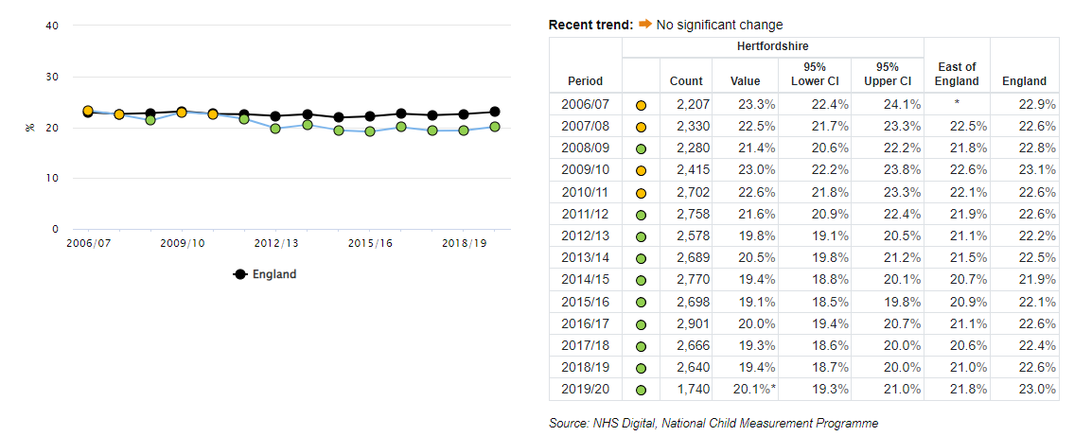
Prevalence of overweight and obesity at Reception in Hertfordshire

Slide 5
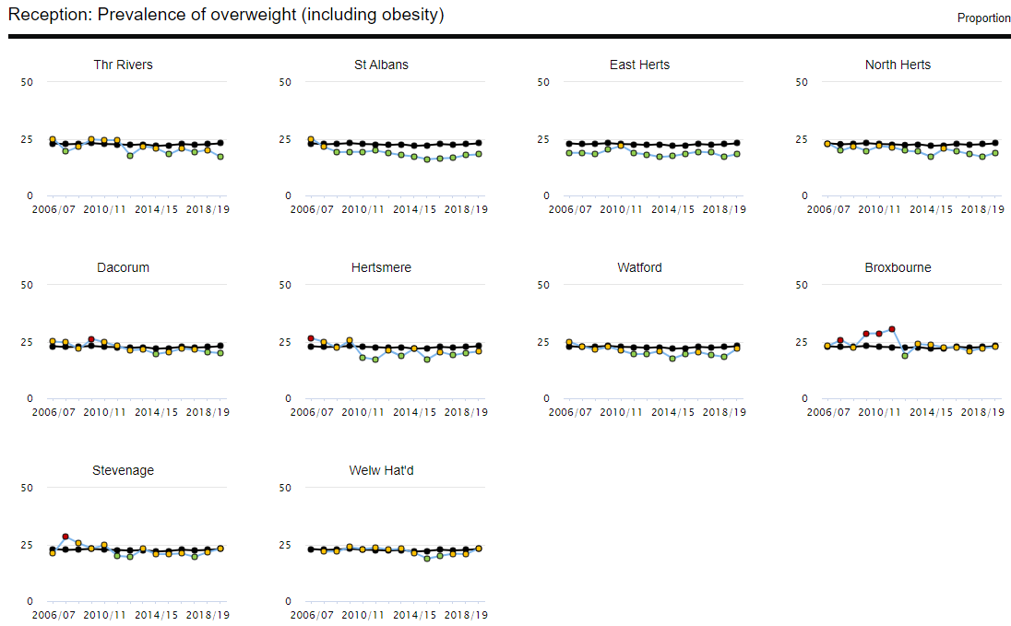
Prevalence of overweight and obesity at Reception in Hertfordshire districts

Slide 6
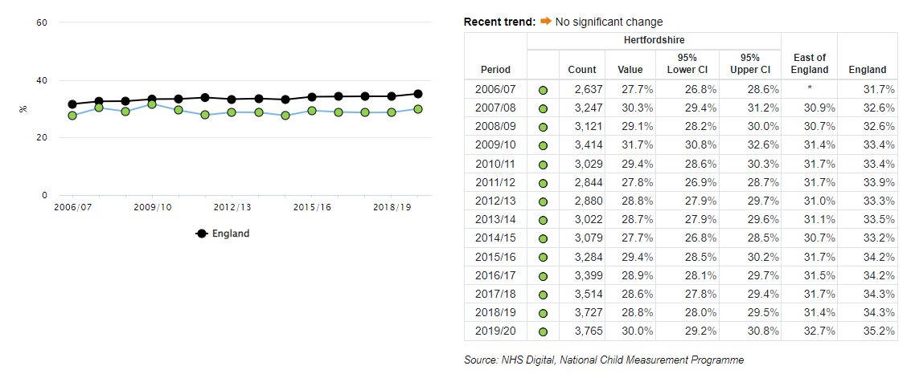
Prevalence of overweight and obesity at Year 6 in Hertfordshire

Slide 7
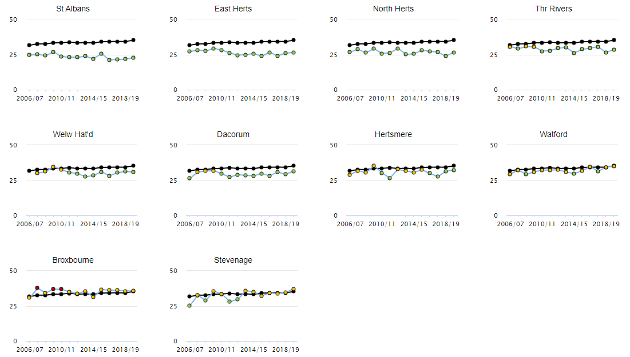
Prevalence of overweight and obesity at Year 6 in Hertfordshire districts

Slide 8
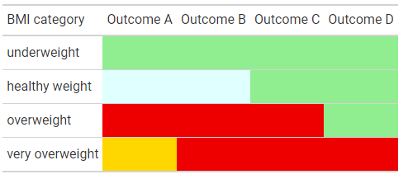
Analysis
Build on previous briefing note last year
Focus on students in year 6 from the 2021/22 school year as the cohort
Uses linked data from their reception years (2013/14) as predictors throughout the pupil’s “lifecourse”
Use machine learning classification algorithms with 10-fold cross-validation to predict whether a pupil will have changed category at year 6
Notes:
As part of a briefing note
Elementary statistical comparisons of changing proportions of BMI classifications, understanding local variation by IMD, ethnicity, area type
Linked data on NHS number
Only two cross sectional timepoints, but enough features and instances

Slide 9
Variables included in enhanced NCMP dataset
Height and z-score
Weight and z-score
BMI and z-score and category
Reception/Yr 6 status
Personal details
IMD decile and ONS geosegmentation based on home address LSOA
IMD decile and ONS geosegmentation based on school address LSOA
Ethnicity
Rural/urban status
BMI category
School postcode distance
+ Additional:
Access to Healthy Assets & Hazards (all domains)
Notes:
Not exhaustive, just more relevant

Slide 10
Sample inclusion and exclusion flowchart for cohort
11222 initial year 6 students with a linked NCMP measurement at reception
n = 11219
n = 10175 (5180 boys, 4995 girls)
Implausible data entries (sex, height at year 6 < height at reception)
n = 3
Missing BMI or height measurement at either reception or Year 6.
n = 1044
Notes:
Could split cohort separately to have missing only height measurement and one which is missing only BMI but that could introduce biases in the sample selection.

Slide 11
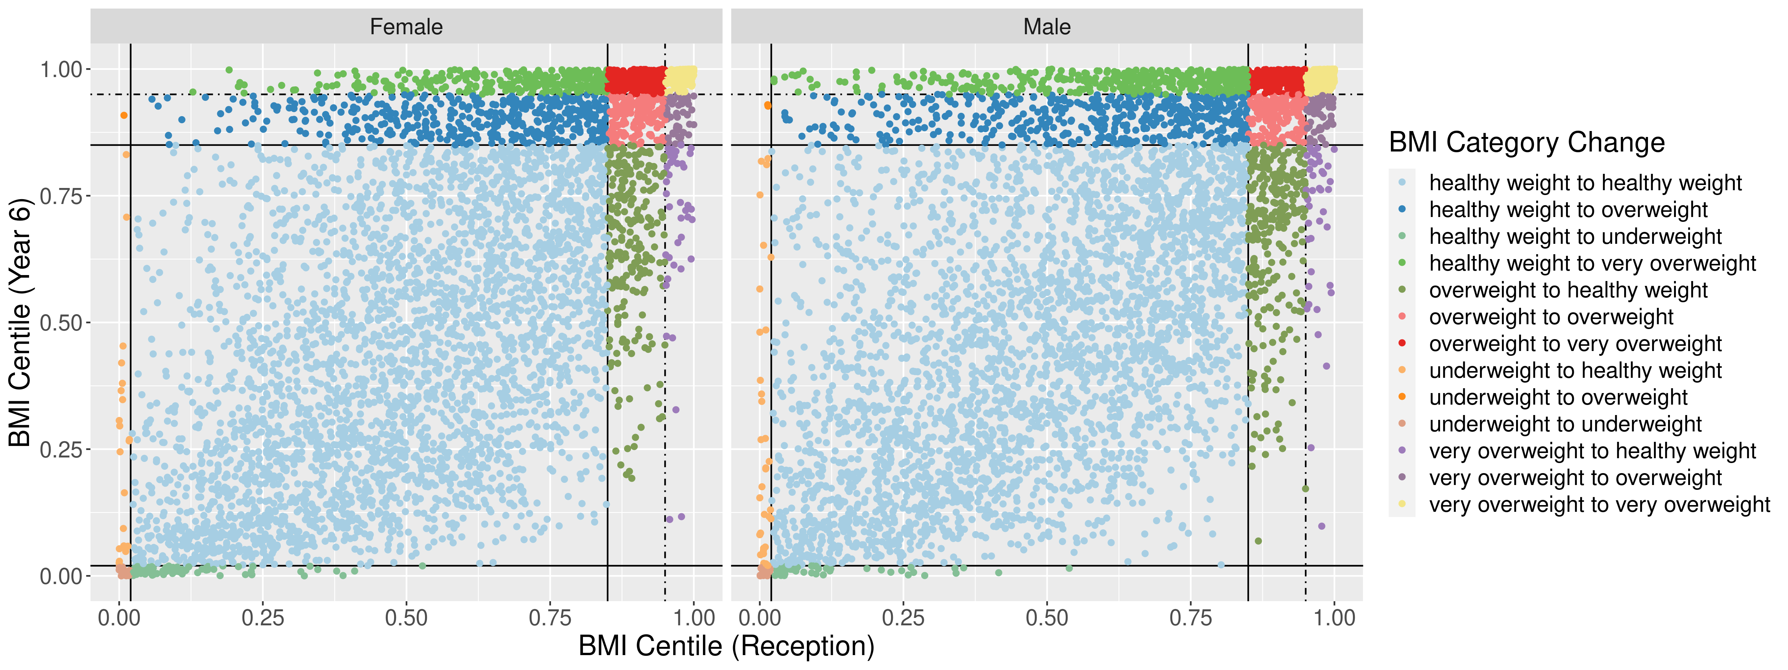
BMI category change – scatter plot

Slide 12
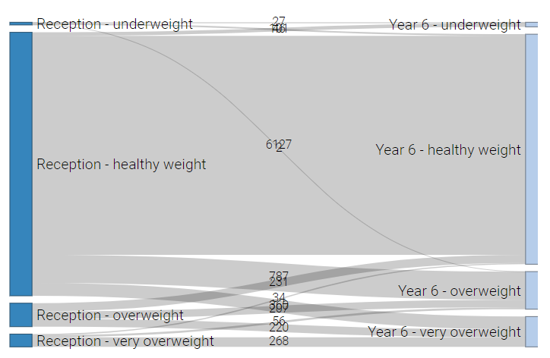
BMI category change – sankey plot

Slide 13
Algorithms used
Random Forest
CART (decision trees)
Multinomial Regression (logistic)
k-nearest neighbours (KNN)

Slide 14
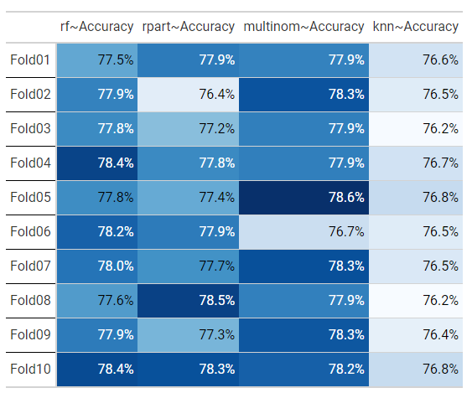
Models evaluation – Outcome A

Slide 15
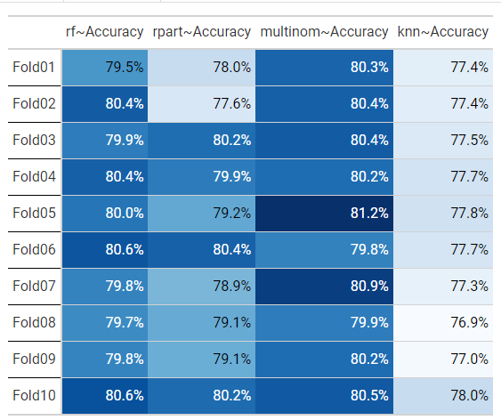
Models evaluation – Outcome B

Slide 16
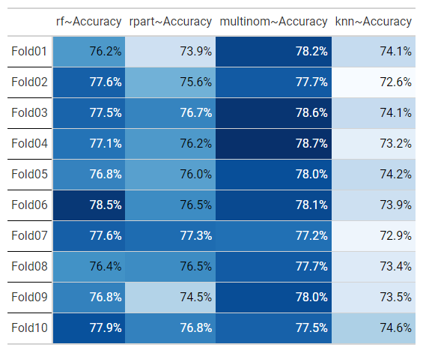
Models evaluation – Outcome C

Slide 17
Models evaluation – Outcome D

Slide 18
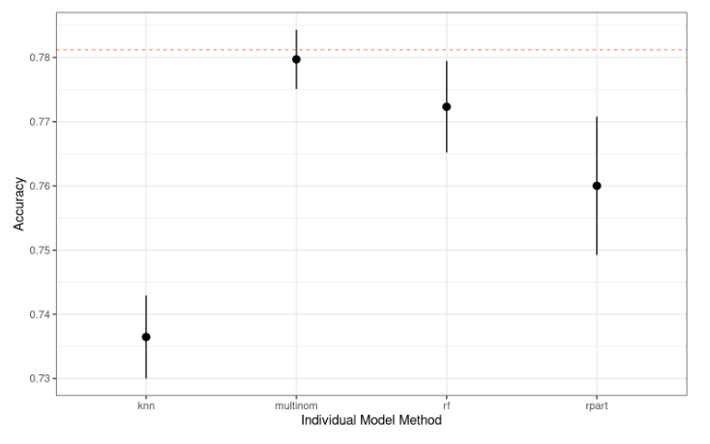
Ensemble evaluation (outcome C/D only)

Slide 19
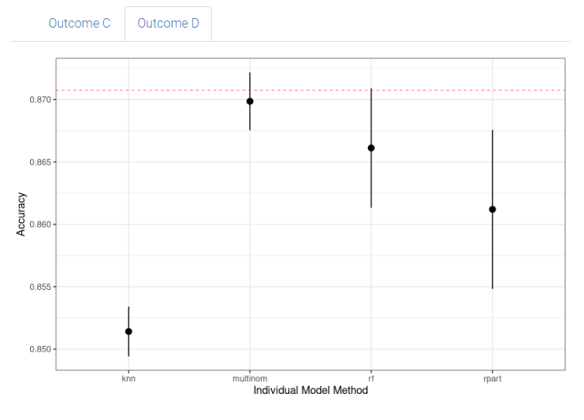
Ensemble evaluation (outcome C/D only)

Slide 20
Additional metrics/confusion matrixes (outcome C)
Random Forest
metric | rf | decision trees | multinom | knn | ensemble_excess6 | dummy
Accuracy | 0.77 | 0.78 | 0.79 | 0.75 | 0.79 | 0.79
Kappa | 0.4 | 0.36 | 0.45 | 0.3 | 0.43 | 0.43
Sensitivity | 0.89 | 0.95 | 0.92 | 0.92 | 0.92 | 0.91
Specificity | 0.48 | 0.36 | 0.49 | 0.33 | 0.47 | 0.49
Pos Pred Value | 0.81 | 0.79 | 0.82 | 0.77 | 0.81 | 0.81
Neg Pred Value | 0.64 | 0.74 | 0.71 | 0.64 | 0.71 | 0.68
Precision | 0.81 | 0.79 | 0.82 | 0.77 | 0.81 | 0.81
Recall | 0.89 | 0.95 | 0.92 | 0.92 | 0.92 | 0.91
F1 | 0.85 | 0.86 | 0.86 | 0.84 | 0.86 | 0.86
Prevalence | 0.71 | 0.71 | 0.71 | 0.71 | 0.71 | 0.71
Detection Rate | 0.63 | 0.68 | 0.65 | 0.66 | 0.66 | 0.64
Detection Prevalence | 0.78 | 0.86 | 0.8 | 0.85 | 0.81 | 0.79
Balanced Accuracy | 0.69 | 0.65 | 0.7 | 0.63 | 0.69 | 0.7
Prediction | Non.Excess.Weight | Excess.Weight
Non.Excess.Weight | 1072 | 253
Excess.Weight | 133 | 234
Decision Trees
Prediction | Non.Excess.Weight | Excess.Weight
Non.Excess.Weight | 1144 | 312
Excess.Weight | 61 | 175
Multinomial
Prediction | Non.Excess.Weight | Excess.Weight
Non.Excess.Weight | 1108 | 250
Excess.Weight | 97 | 237
knn
Prediction | Non.Excess.Weight | Excess.Weight
Non.Excess.Weight | 1113 | 325
Excess.Weight | 92 | 162
knn
Prediction | Non.Excess.Weight | Excess.Weight
Non.Excess.Weight | 1112 | 260
Excess.Weight | 93 | 227

Slide 21
Additional metrics/confusion matrixes (outcome C)
Random Forest
metric | rf | decision trees | multinom | knn | ensemble_excess6 | dummy
Accuracy | 0.77 | 0.78 | 0.79 | 0.75 | 0.79 | 0.79
Kappa | 0.4 | 0.36 | 0.45 | 0.3 | 0.43 | 0.43
Sensitivity | 0.89 | 0.95 | 0.92 | 0.92 | 0.92 | 0.91
Specificity | 0.48 | 0.36 | 0.49 | 0.33 | 0.47 | 0.49
Pos Pred Value | 0.81 | 0.79 | 0.82 | 0.77 | 0.81 | 0.81
Neg Pred Value | 0.64 | 0.74 | 0.71 | 0.64 | 0.71 | 0.68
Precision | 0.81 | 0.79 | 0.82 | 0.77 | 0.81 | 0.81
Recall | 0.89 | 0.95 | 0.92 | 0.92 | 0.92 | 0.91
F1 | 0.85 | 0.86 | 0.86 | 0.84 | 0.86 | 0.86
Prevalence | 0.71 | 0.71 | 0.71 | 0.71 | 0.71 | 0.71
Detection Rate | 0.63 | 0.68 | 0.65 | 0.66 | 0.66 | 0.64
Detection Prevalence | 0.78 | 0.86 | 0.8 | 0.85 | 0.81 | 0.79
Balanced Accuracy | 0.69 | 0.65 | 0.7 | 0.63 | 0.69 | 0.7
Prediction | Non.Excess.Weight | Excess.Weight
Non.Excess.Weight | 1072 | 253
Excess.Weight | 133 | 234
Decision Trees
Prediction | Non.Excess.Weight | Excess.Weight
Non.Excess.Weight | 1144 | 312
Excess.Weight | 61 | 175
Multinomial
Prediction | Non.Excess.Weight | Excess.Weight
Non.Excess.Weight | 1108 | 250
Excess.Weight | 97 | 237
knn
Prediction | Non.Excess.Weight | Excess.Weight
Non.Excess.Weight | 1113 | 325
Excess.Weight | 92 | 162
knn
Prediction | Non.Excess.Weight | Excess.Weight
Non.Excess.Weight | 1112 | 260
Excess.Weight | 93 | 227

Slide 22
Additional metrics/confusion matrixes (outcome C)
Random Forest
metric | rf | decision trees | multinom | knn | ensemble_excess6 | dummy
Accuracy | 0.77 | 0.78 | 0.79 | 0.75 | 0.79 | 0.79
Kappa | 0.4 | 0.36 | 0.45 | 0.3 | 0.43 | 0.43
Sensitivity | 0.89 | 0.95 | 0.92 | 0.92 | 0.92 | 0.91
Specificity | 0.48 | 0.36 | 0.49 | 0.33 | 0.47 | 0.49
Pos Pred Value | 0.81 | 0.79 | 0.82 | 0.77 | 0.81 | 0.81
Neg Pred Value | 0.64 | 0.74 | 0.71 | 0.64 | 0.71 | 0.68
Precision | 0.81 | 0.79 | 0.82 | 0.77 | 0.81 | 0.81
Recall | 0.89 | 0.95 | 0.92 | 0.92 | 0.92 | 0.91
F1 | 0.85 | 0.86 | 0.86 | 0.84 | 0.86 | 0.86
Prevalence | 0.71 | 0.71 | 0.71 | 0.71 | 0.71 | 0.71
Detection Rate | 0.63 | 0.68 | 0.65 | 0.66 | 0.66 | 0.64
Detection Prevalence | 0.78 | 0.86 | 0.8 | 0.85 | 0.81 | 0.79
Balanced Accuracy | 0.69 | 0.65 | 0.7 | 0.63 | 0.69 | 0.7
Prediction | Non.Excess.Weight | Excess.Weight
Non.Excess.Weight | 1072 | 253
Excess.Weight | 133 | 234
Decision Trees
Prediction | Non.Excess.Weight | Excess.Weight
Non.Excess.Weight | 1144 | 312
Excess.Weight | 61 | 175
Multinomial
Prediction | Non.Excess.Weight | Excess.Weight
Non.Excess.Weight | 1108 | 250
Excess.Weight | 97 | 237
knn
Prediction | Non.Excess.Weight | Excess.Weight
Non.Excess.Weight | 1113 | 325
Excess.Weight | 92 | 162
knn
Prediction | Non.Excess.Weight | Excess.Weight
Non.Excess.Weight | 1112 | 260
Excess.Weight | 93 | 227

Slide 23
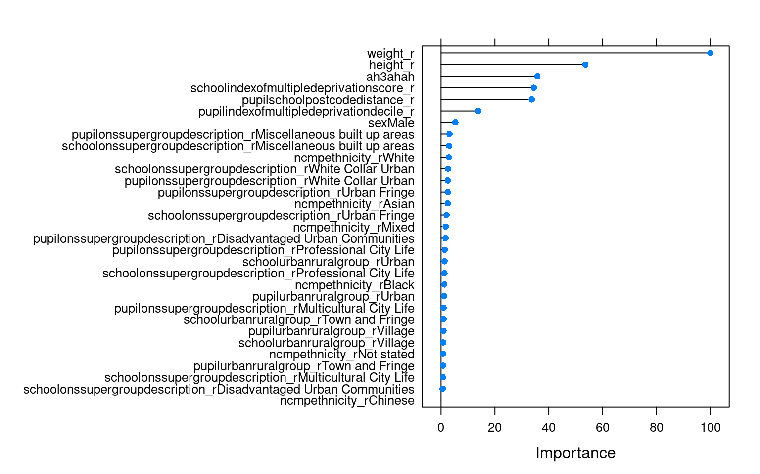
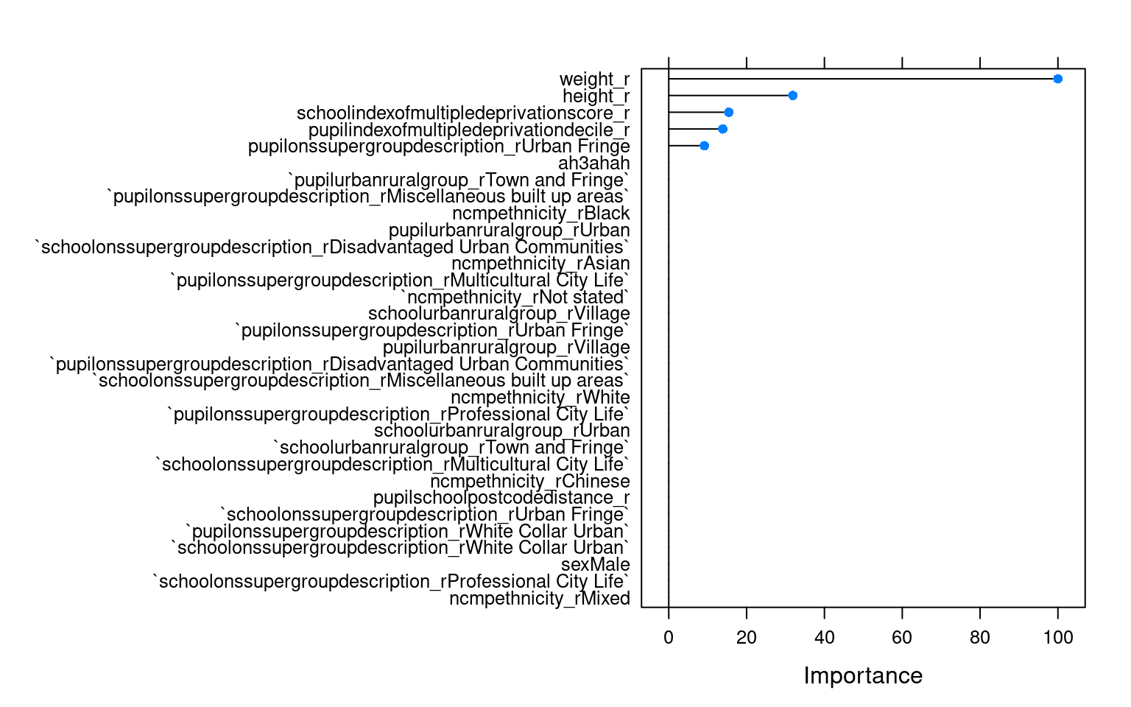
Variable Importance
Random Forest
Decision Trees

Slide 24
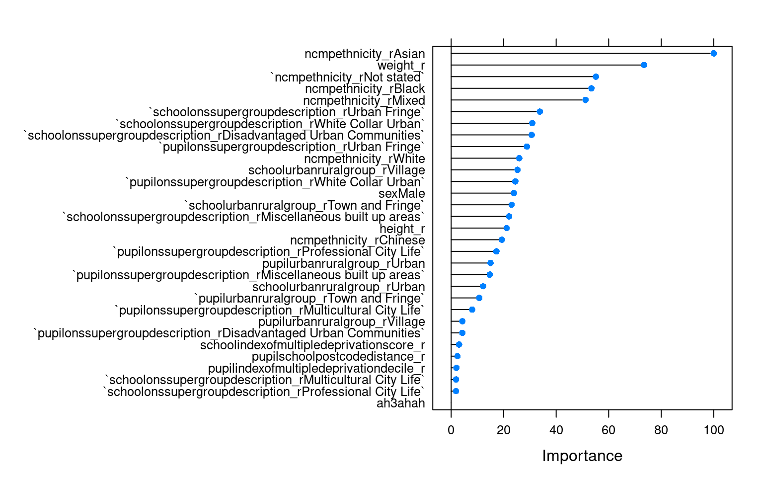
Variable Importance
Multinomial Regression

Slide 25
Conclusions
Feasibility of using locally extracted Hertfordshire data from the NCMP dataset in predicting a student’s weight status
Accuracy figures reaching 80%
Sensitivity, reaching 90%.
However, specificity fairly poor

Slide 26
Implications for policy/practice
Understand what variables/risk factors which are predictive of future BMI status
Focus resources and possibly identify children at risk in future year groups
Improve local planning and delivery of services
Link to wider determinants of health
Notes:
What we’re hoping doing as the data comes in for the next cohort of students in the 2022/2023 year group this year, is to run the model which we will have validated on the dataset of the previous year’s cohort we’ve used
School meals, nutrition, physical exercise, deprivation, etc. all linked

Slide 27
Extensions
Implementation of tidymodels framework
Inclusion of clinical and non-clinical datasets held by the Hertfordshire Community NHS Trust
Hyperparameter tuning
Approach target variable as raw BMI (continuous)
Notes:
Antenatal and maternal data would be incredibly insightful as it would combine the public health aspects of the NCMP data with .clinical history about children, their mothers
Mention Univ of Southampton doing similar study with the SLOPE study - Data | Studying Lifecourse Obesity PrEdictors (SLOPE) Study | University of Southampton

